Slide 1
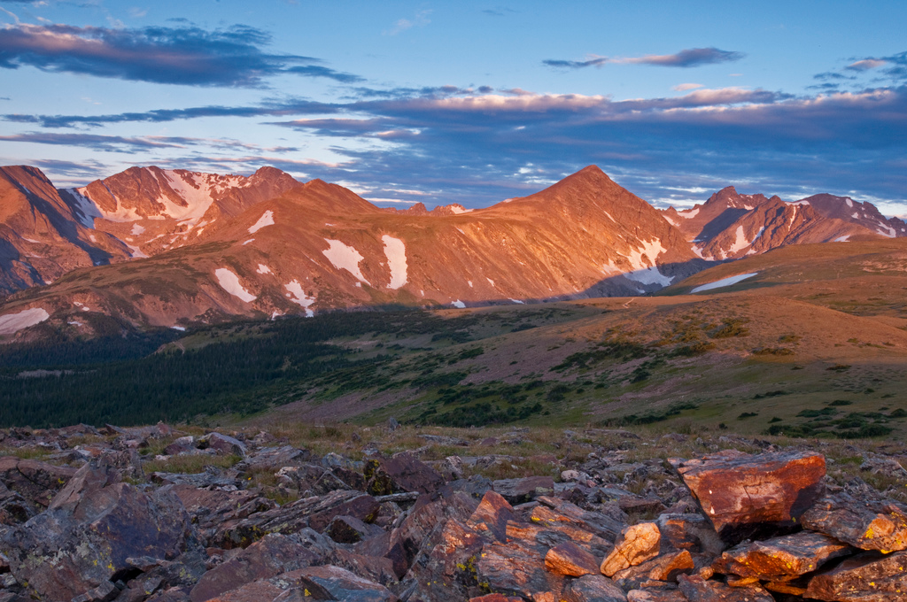
Niwot Ridge LTER

Slide 2
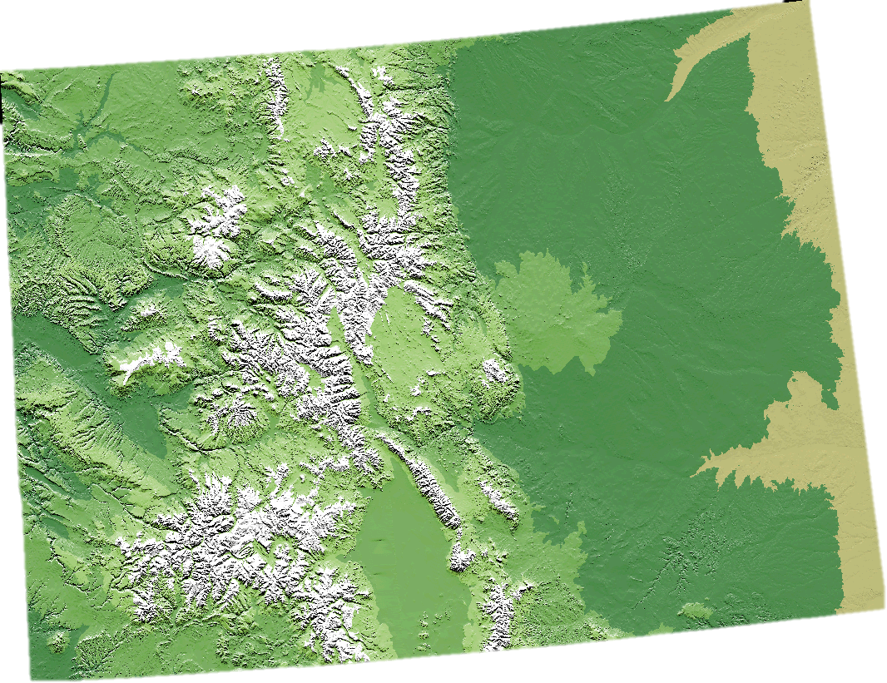
Niwot Ridge, Colorado

Slide 3
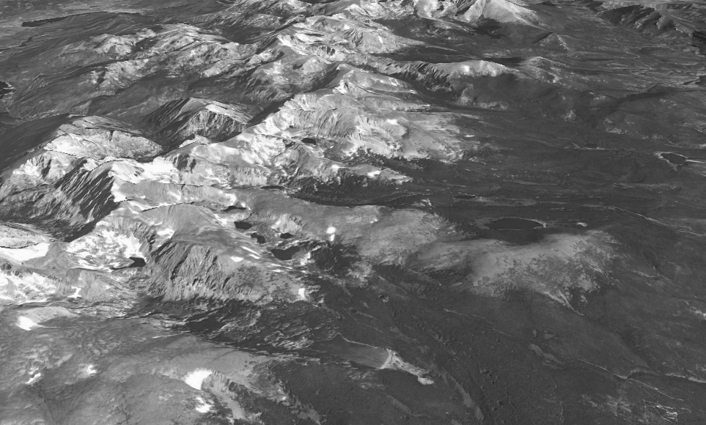

Niwot Ridge, Colorado

Slide 4
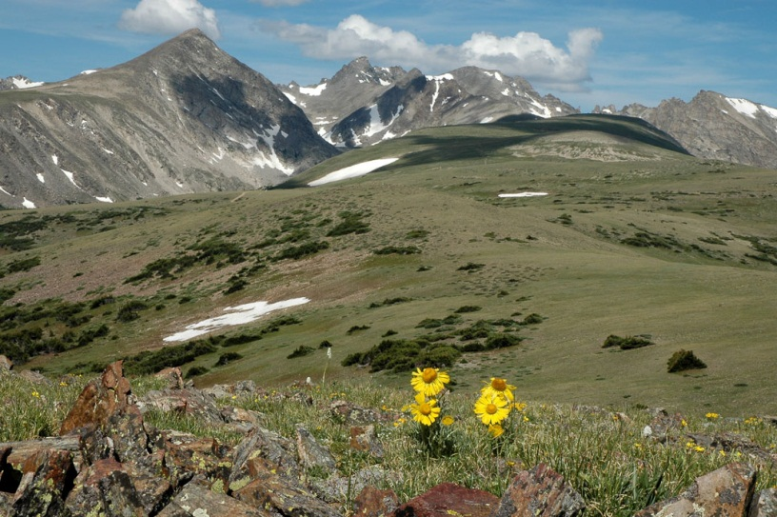
Niwot Ridge, Colorado

Slide 5
Spatial heterogeneity

Slide 6
Spatial heterogeneity
Snow depth:
Growing season & moisture availability

Slide 7
Temporal change

Slide 8
Temporal change
Climate change:
Longer summers & more extremes

Slide 9
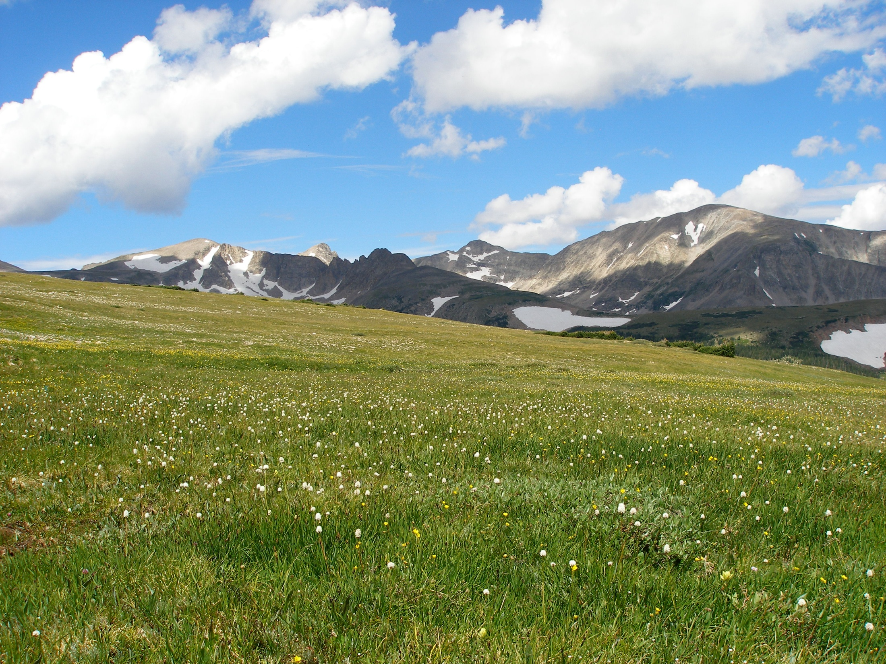
Saddle grid:
8 x 11 grid, 4 habitats
9 points across 20 years
Spatial data:
Elevation
Temporal data:
Climate variables
Spatial x temporal:
Species composition
Snow depth

